Slide 1

Un gran poder conlleva
una gran responsabilidad
Juan Carlos Martínez García – Alberto Diaz Martin
Notes:
WiFi Network: MSFT_GUEST
Username: O365Speaker@outlook.com
Password: 5784

Slide 2


Juan Carlos Martínez García
Cloud Solutions Developer
ENCAMINA
http://blogs.encamina.com/piensa-en-software-desarrolla-en-colores/
@jcmartinezg23
Developer at ENCAMINA. Hago cosas.

Slide 3

Alberto Diaz Martin
CTIO – Azure MVP
ENCAMINA
http://blogs.encamina.com/por-una-nube-sostenible/
@adiazcan
Geek, smartphone lover and developer

Slide 4
Notes:
This slide is mandatory. Please do not remove and try to use it during Q&A at the end of your session. Thank you!

Slide 5
SharePoint Development
 | SP 2007 | SP 2010 | SP 2013 | SP 2016 | O365/SPO
Full Trust Code Solutions | YES | YES | YES | YES | NO
ASMX web services | YES | YES | YES | YES** | YES**
Sandbox solutions | NO | YES | YES* | YES* | YES*
CSOM/REST API’s | NO | YES | YES | YES | YES
Add-ins | NO | NO | YES | YES | YES
SharePoint Framework | NO | NO | NO | NO | YES
* Only declarative sandbox solutions are supported. Code solutions are deprecated (and will be turned off on O365/SPO)
** Still available, but the recommendation to switch to CSOM/REST API’s which might indicate that the ASMX services will be deprecated in the near future

Slide 6
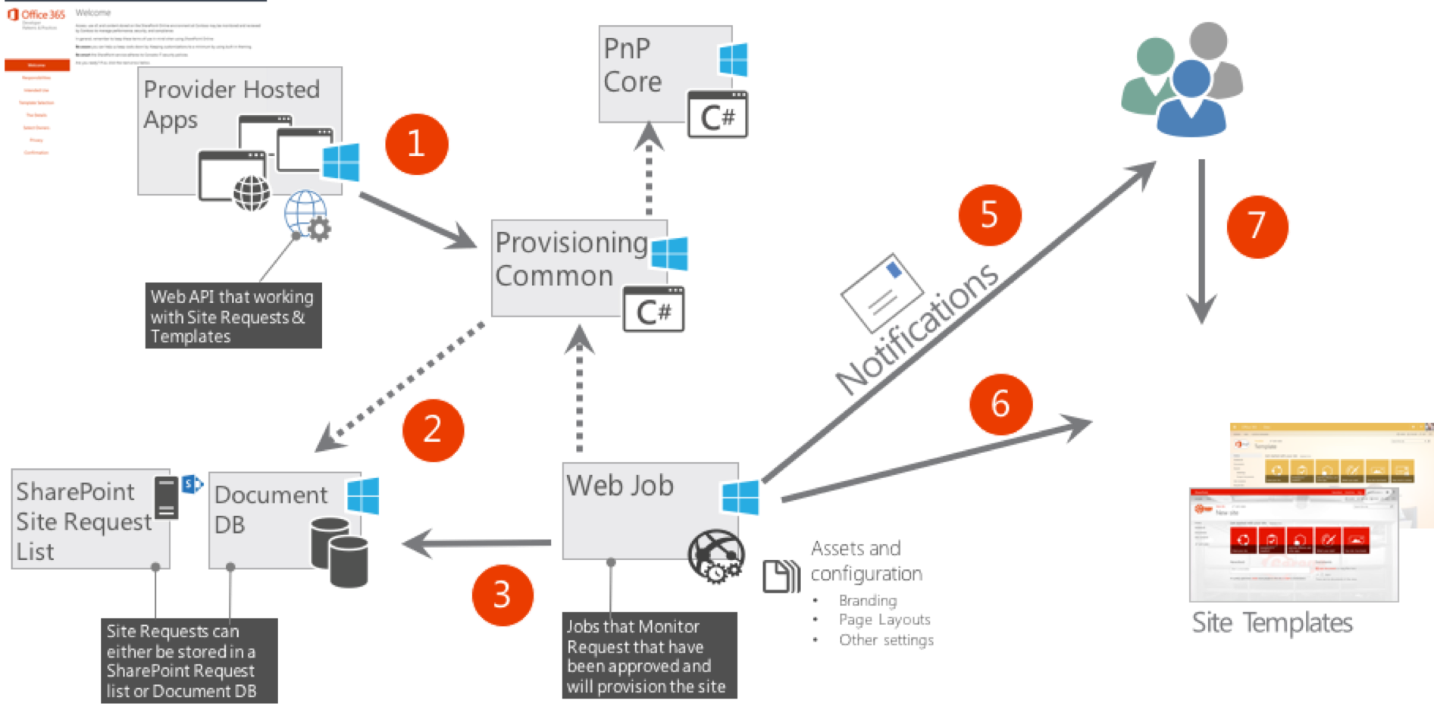
SharePoint Online Remote Provisioning

Slide 7
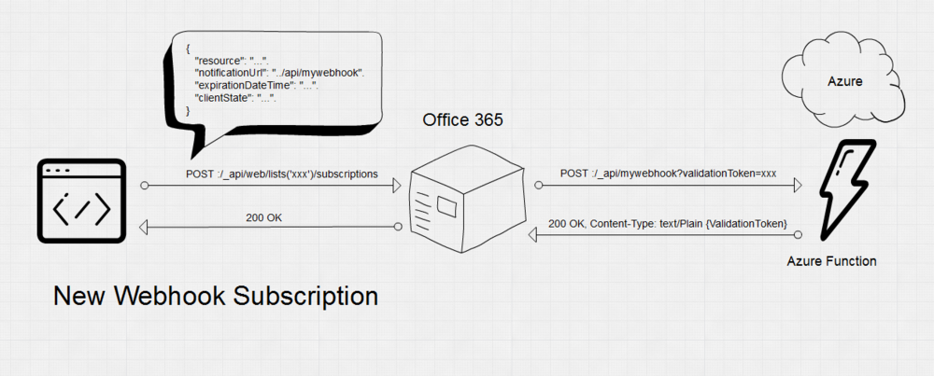
SharePoint Online Webhook en Azure Function

Slide 8
SharePoint Online Provisionado

Slide 9
SharePoint Online Provisionado

Slide 10




Slide 11
Efficient querying via SharePoint API’s
Only request the properties you need in Load/LoadQuery methods
Limits required bandwidth
Limits memory consumption
Only retrieve the objects and properties you need
LoadQuery method
Let SharePoint do the processing
On very large sites (e.g. with thousands of lists), if you retrieve all properties, this can easily lead to time-outs.

Slide 12
Efficient querying via SharePoint API’s
Use batching to perform large operations
Resolving 1000 users in one batch results in a timeout after the default 90 seconds timeout
Using a batch size of 100 users, there are 10 requests required and all calls succeed in a total of ~2 minutes
Same approach can be used for batch updates to list items, read operations or other large operations you might want to perform against SharePoint

Slide 13
Efficient querying via SharePoint API’s
When using a token to authenticate:
Cache your tenant’s realm/token for multiple requests
A token is valid for one hour, so you only need to refresh/re-request it again after one hour
If you request it for every ExecuteQuery, this delays the request and consumes additional SPO resources and bandwidth
Be aware that in SharePoint Online, if a site does not exist it throws a forbidden error when trying to request a token or performing an ExecuteQuery
To avoid this, it’s best to first perform a WebClient request as this will properly respond with a “404 Not Found” code if the site does not exist

Slide 14
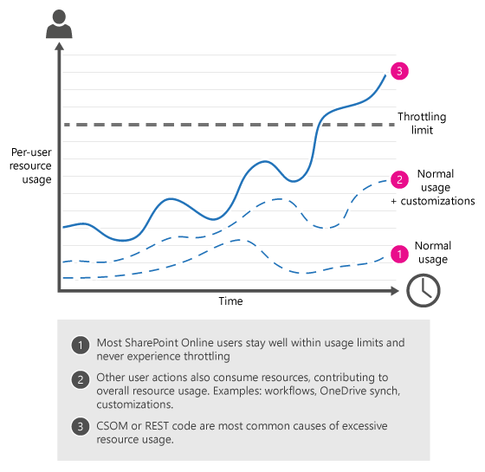
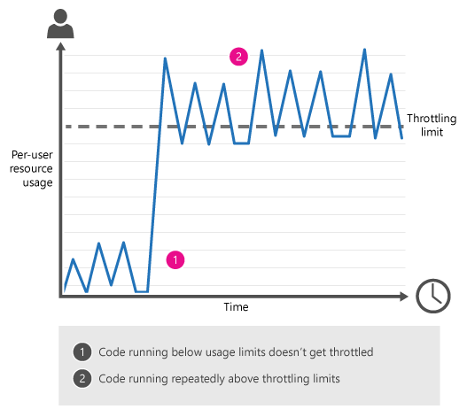
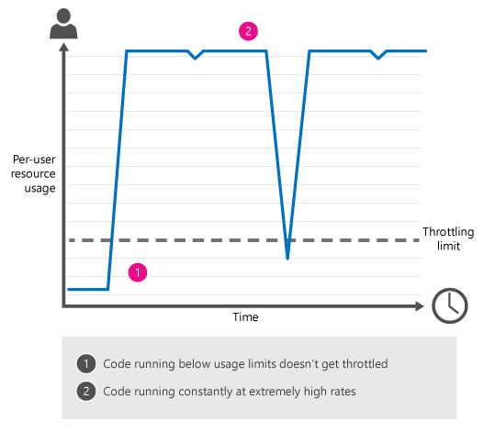
Handling throttling and network outages
SharePoint Online uses throttling to maintain optimal performance and reliability of the SharePoint Online service. Throttling limits the number of user actions or concurrent calls (by script or code) to prevent overuse of resources
throttling design sporadic traffic overwhelming traffic
Notes:
https://docs.microsoft.com/en-us/sharepoint/dev/general-development/how-to-avoid-getting-throttled-or-blocked-in-sharepoint-online#BKMK_Whatshouldyoudoifyougetblocked

Slide 15
Handling throttling and network outages
If a ExecuteQuery is throttled by SharePoint, it throws a HTTP status code 429: “Too many requests”
You can catch this error code and implement a cool down and retry mechanism
The Core.Throttling example from the PnP framework has the “ExecuteQueryWithIncrementalRetry” extension method to catch HTTP codes 429 and 503
If you also want to catch any other unexpected errors (like timeouts/network outages), you can implement the same approach

Slide 16



…if cloud computing was transportation
IaaS
PaaS
Serverless
…you can buy or lease a car and maintain it yourself

Slide 17
…if cloud computing was transportation
IaaS
PaaS
Serverless
…you can buy or lease a car and maintain it yourself
…you can rent a car
…you can rent a car and pay for having it around even when you are not driving

Slide 18
…if cloud computing was transportation
IaaS
PaaS
Serverless
…you can buy or lease a car and maintain it yourself
…you can rent a car
…you can use a ride sharing app pay only for transportation
…you can rent a car and pay for having it around even when you are not driving

Slide 19
Azure Functions Architecture
Functions
Runtime
Functions Programming Interface
Input Bindings
Triggers
Output Bindings
App Service
App Hosting Plans

Slide 20
Best practices for the “Functions” programming model
Functions should “do one thing”
Functions should be stateless and idempotent
Functions should finish as quickly as possible
1
Notes:
Habría que comentar también las best practices para las durable function, esto es:
El orchestrator no tiene que hacer ningún tipo de I/O, lanzar timers a través de algo que no sea el propio contexto ni tampoco lanzar código asíncrono salvo los métodos que ofrece el contexto
Cualquiera de estas cosas, se pueden lanzar en la actividad
Evitar bucles infinitos, si queremos que una function se lance “eternamente” –> ContinueAsNew (limpia historial y no retiene <recursos)

Slide 21
Platform and scaling
Dynamic
Platform handles scalability
Pay based on
# of executions
Amount of memory
Duration of execution
Dedicated
Choose any of the App Service plan tiers
Basic, Standard, Premium
Pay based on # and size of reserved VMs
You’re responsible for scale
Popular!
Great if you already have an app service

Slide 22

Demo Azure Functions escalando

Slide 23
Error 429, 503,…
HTTP Error 429 → Too many requests ☹
Solutions:
- Reduce the number of operations per request
- Reduce the frequency of calls
- Decorate your traffic so we know who you are

Slide 24
Demo Error 429

Slide 25
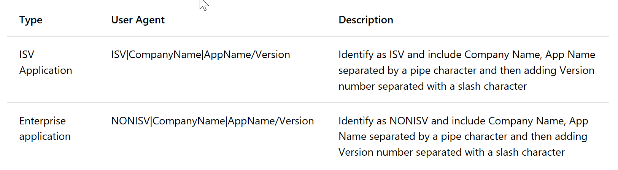
Decorate your traffic
Include a User Agent string

Slide 26
Incremental retry
Catching WebException 429 or 503
Suspend current thread for a period of time
On resume increment backoff interval
Repeat until ExecuteQuery successfully

Slide 27
Demo ExecuteQueryWithRetry

Slide 28
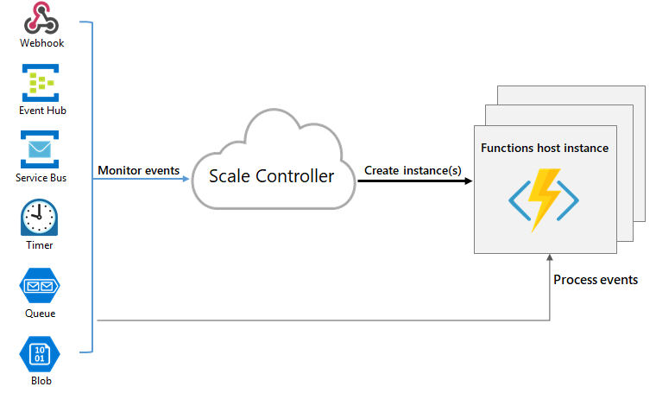
Limit Azure Functions
Azure Function has 5/10 minutes execution
Divide on micro-functions increase the number of request to SharePoint
Of course, don’t do in parallel
Try limit your Azure Functions

Slide 29
Azure Functions scaling
A single function app will only scale to a maximum of 200 instances. A single instance may process more than one message or request at a time though, so there isn't a set limit on number of concurrent executions.
New instances will only be allocated at most once every 10 seconds.
maxConcurrentRequests → The maximum number of http functions that will be executed in parallel
Durable Functions
maxConcurrentActivityFunctions
maxConcurrentOrchestratorFunctions

Slide 30
Demo Control Azure Function

Slide 31
What happen if I can’t divide my Function?
or I can avoid execution time limit?

Slide 32
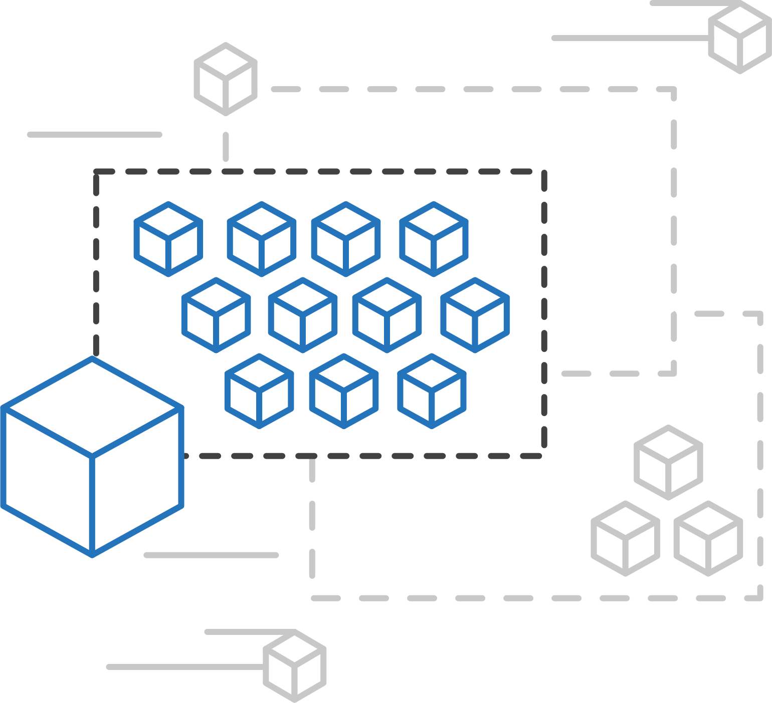
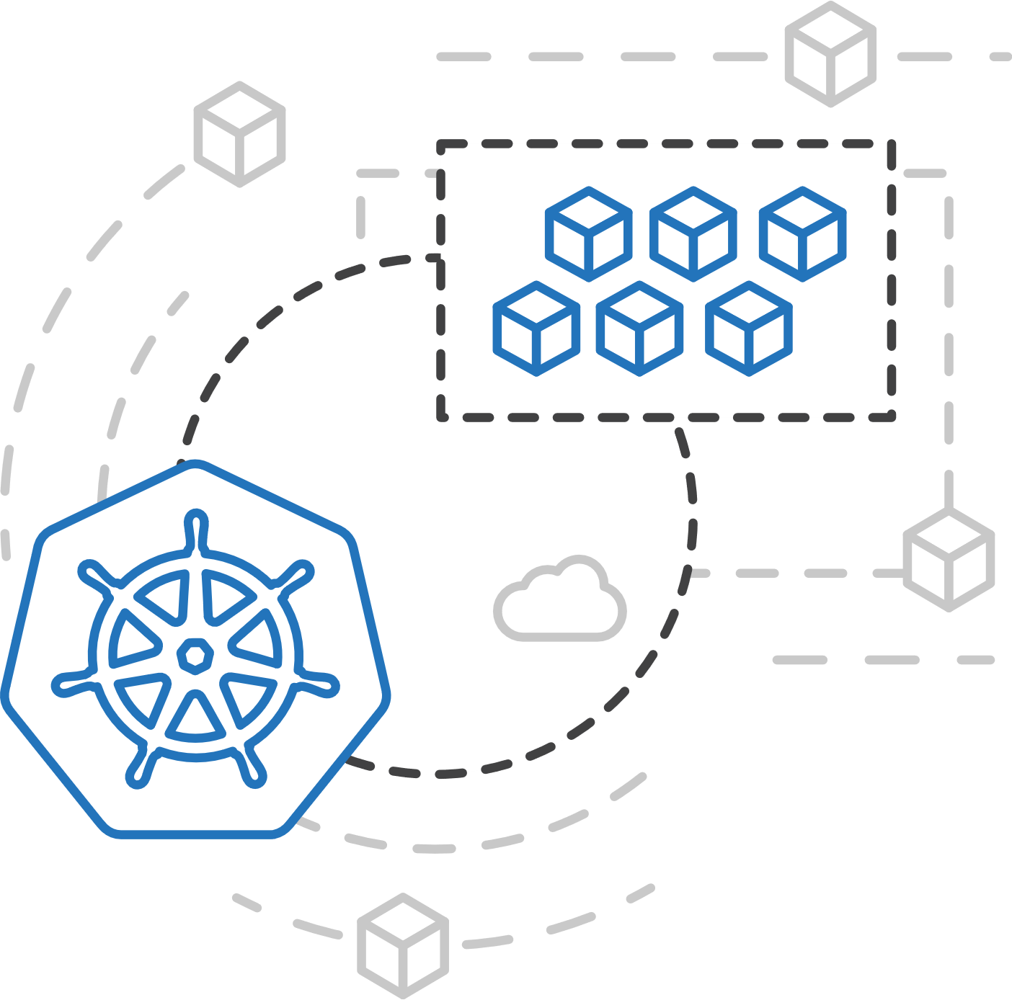
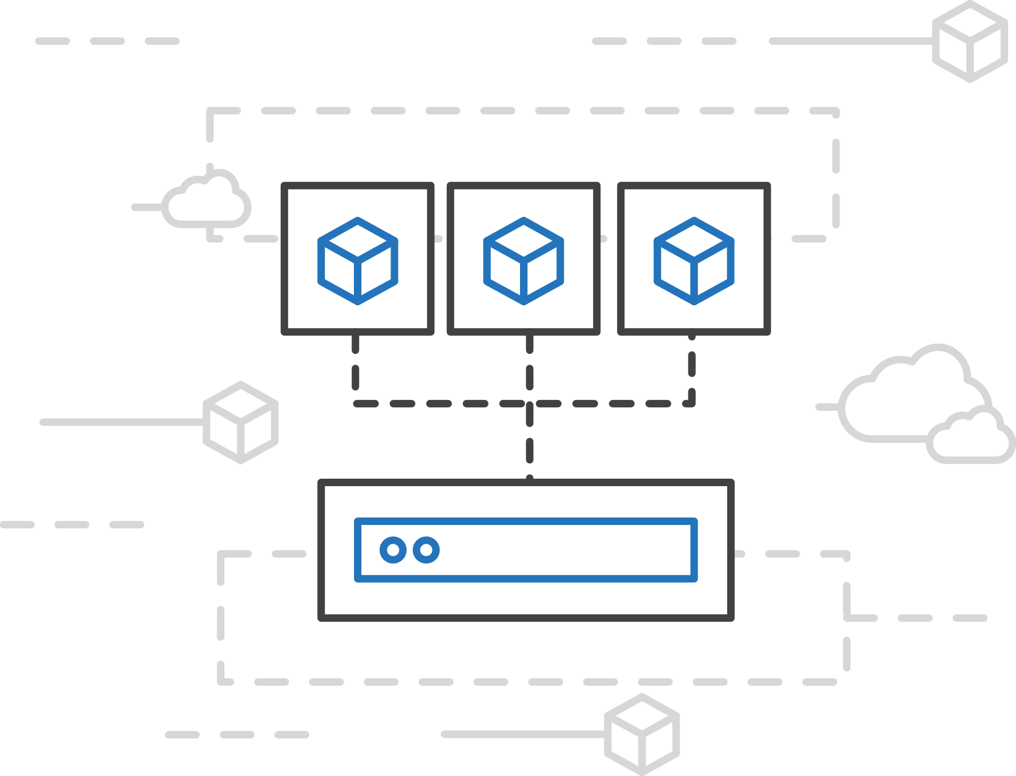
Azure Container Instances (ACI)
Easily run containers without managing servers
Run containers without managing servers
Containers as a primitive billed per second
Secure applications with hypervisor isolation

Slide 33




Why ACI?
Invisible infrastructure
Micro-billing
Modularity

Slide 34
Demo Azure Container Instance

Slide 35

Resume
Be careful with throttling and network outages
Execute with retry
User Agent
You have a lot of CPUs on Azure and It can break your SharePoint
Divide as you can your code
Limit your instances

Slide 36

@adiazcan
@jcmartinezg23

Slide 37
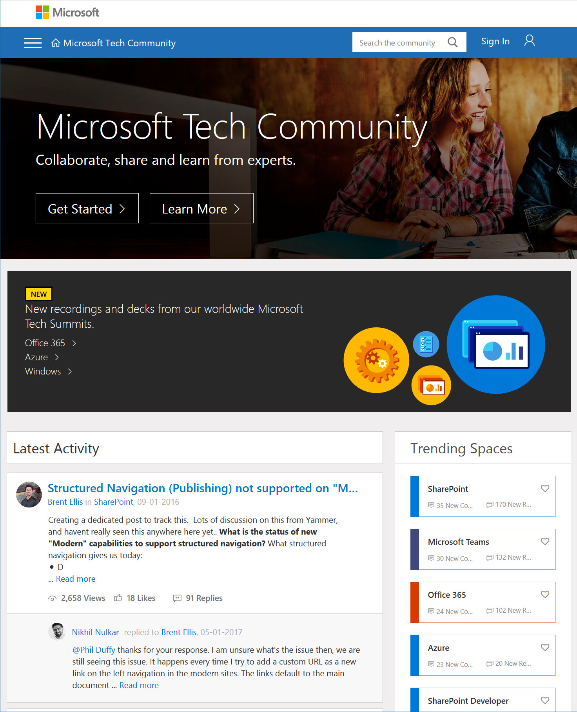
Microsoft Tech Community
techcommunity.microsoft.com
One Microsoft community for IT Pros and tech enthusiasts to learn from experts on Microsoft products
Trusted resource for news, best practices and answers from Microsoft product teams and MVPs
Join today! It’s free – sign in with your Microsoft Account.

Slide 38
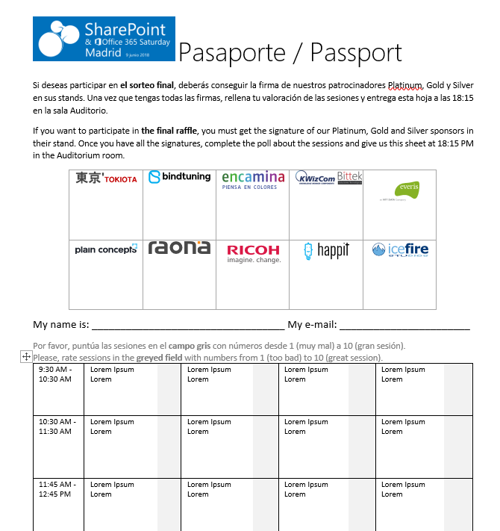

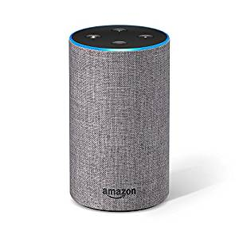













Raffle
Please, fill your SP & Office 365 Saturday Madrid passport if you want to participate.
You can win one of these gifts:
Please, fill your SP & Office 365 Saturday Madrid passport if you want to participate.
You can win one of these gifts:
Odor
Odor@winterfell.com
10
9
2x
2x
8

Slide 39
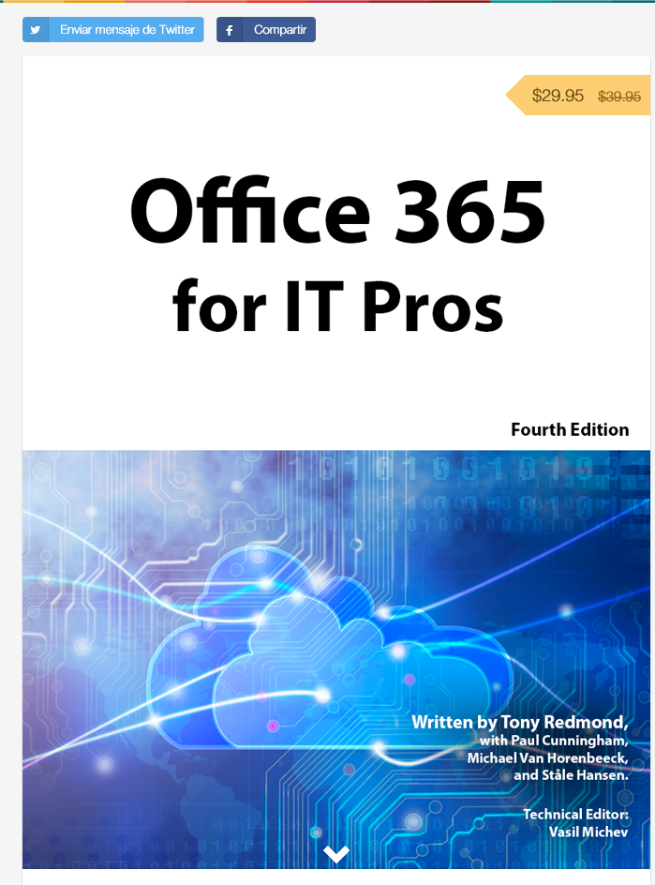
Office 365 for IT Pros
Get a discount of $10 buying the book here: https://gumroad.com/l/O365IT/spsspain

Slide 40
Notes:
This slide is mandatory. Please do not remove and try to use it during Q&A at the end of your session. Thank you!

Slide 41
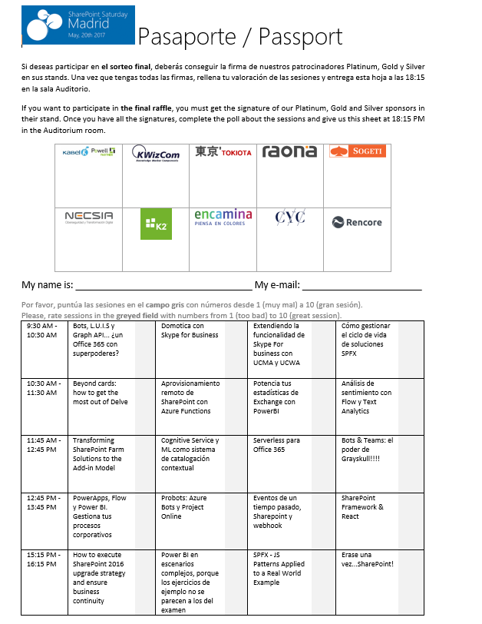
Raffle
Please, fill your SP & Office 365 Saturday Madrid passport if you want to participate.
You can win one of these gifts:
Odor
Odor@winterfell.com
10
9
8

